Slide 1
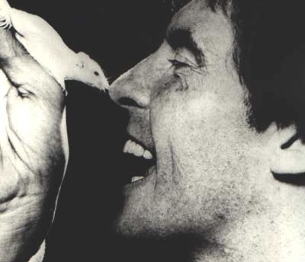
Flowers for Algernon
Language Arts

Slide 2
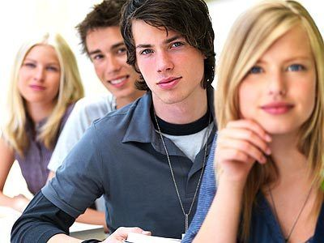
Class Poll
Would it be better to be the most popular person in your school, or the smartest person in your school?
Discuss your reasons.

Slide 3
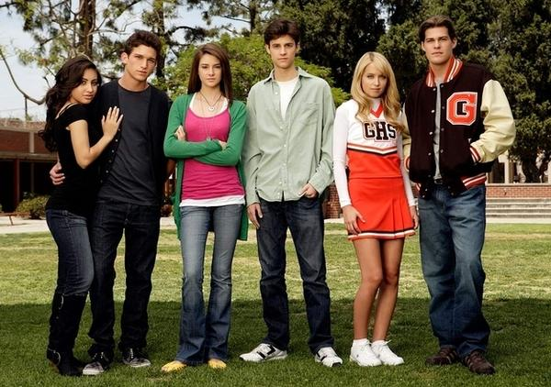
Let’s take it a step further…
Do you think it’s possible to be both the most popular kid as well as the smartest kid?
Why or why not?

Slide 4
Take a Moment…
Respond to the handout regarding some of your opinions on similar topics. We will then share and discuss as a class.

